Slide 1
The 2014 Farm Bill’s Dairy Sub-Title and Dairy Producer Margin Protection Program
Prof. Brian W. Gould
Dept. of Agricultural and Applied Economics
University of Wisconsin-Madison
University of Wisconsin Extension
7th District Agricultural Credit Companies
2014 Fall Conference
October 24, 2014

Slide 2
Dairy Marketing and Policy
(DMaP) Group
Inter-university group of dairy economists
  Cornell University: A. Novakovic
  Michigan State University: C. Wolfe
  The Ohio State University: C. Thraen
  Penn. State University: C. Nicholson
  University of Illinois: J. Newton
  University of Minnesota: M. Bozic
  University of Wisconsin: M. Stephenson &
  B.W. Gould
Multi-year agreement with USDA’s, Farm Service Agency to provide MPP educational programming and decision software development

Slide 3






The following USDA grant is acknowledged: USDA-NIFA Award No. 2012-49200-20032
Dairy Marketing and Policy
(DMaP) Group

Slide 4
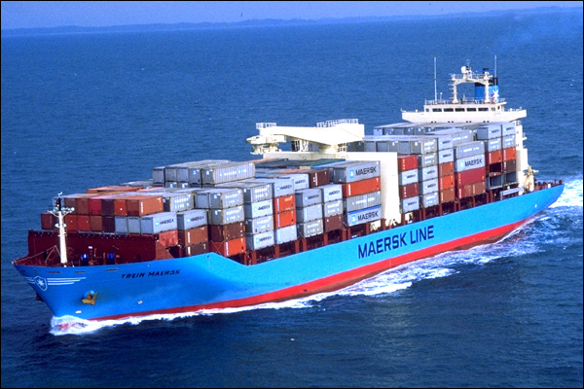
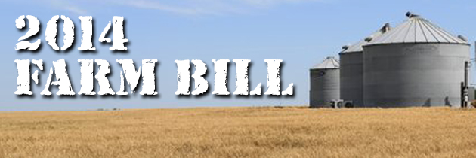
Major Dairy Provisions of the 2014 Farm Bill
Repeals: Dairy Product Price Support Program (i.e., DPPSP)
Repeals: Dairy Export Incentive Program (i.e., DEIP)
Renews: Dairy forward pricing program for Class II – Class IV milk purchased by private dairy product manufacturers
  Cooperatives have always had this ability

Slide 5
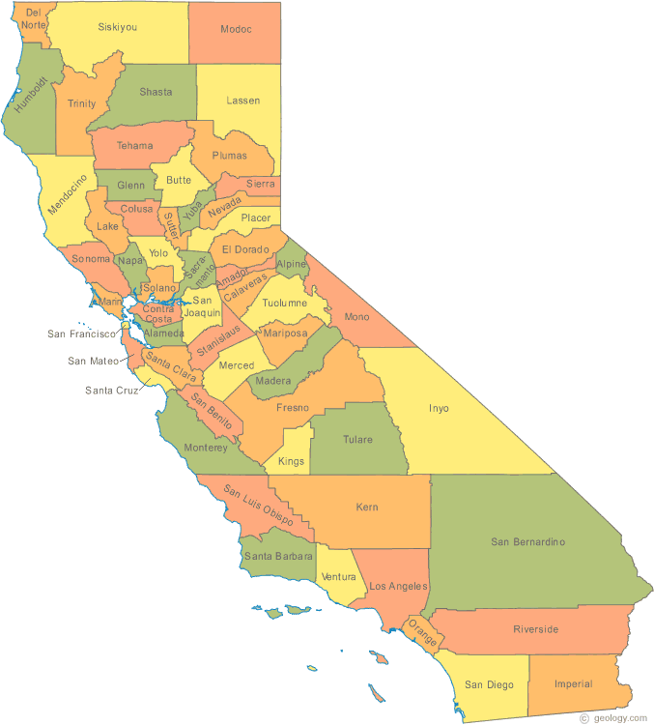
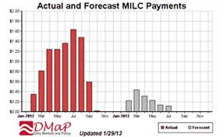
Major Dairy Provisions of the 2014 Farm Bill
Provides for entrance of California into FMMO system
  If desired by California producers
  Maintains a portion of their quota system
  Would probably be its own order
Repeals Milk Income Loss Contract program after January, 2015

Slide 6
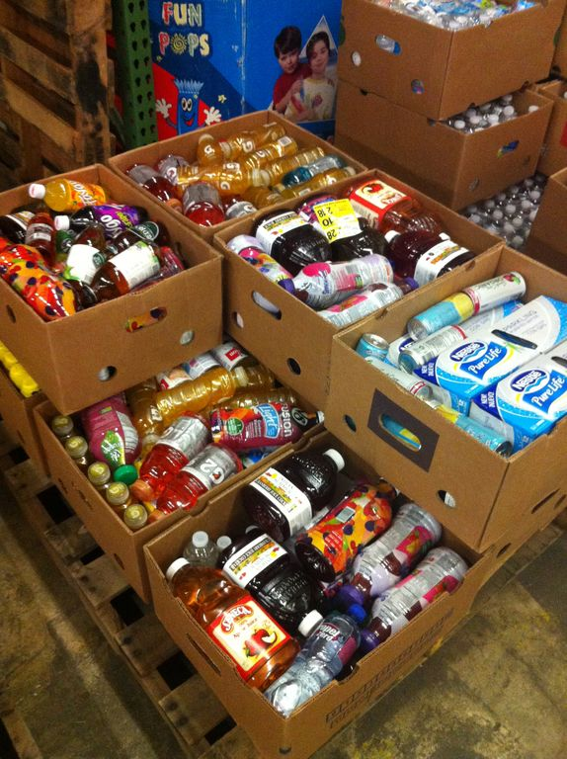
Major Dairy Provisions of the 2014 Farm Bill
Creates Dairy Product Donation Program (DPDP)
  Initiated when Income Over Feed Cost (IOFC) goes below $4/cwt
    IOFC as defined under the MPP
  Considerable latitude in determining amount of dairy products to purchase
  Unlike DPPSP, dairy purchases under program cannot enter commercial market but must be donated

Slide 7


The Margin Protection Program
Creates the Dairy Producer Margin Protection Program (MPP)
  Voluntary program
  Protects dairy producers from lower mailbox price, increasing feed costs, or both
  Pays indemnities when difference between
    USDA’s average national All-Milk price and
    A program-defined fixed feed ration valued at U.S. average feed prices
    Falls below producer chosen insured IOFC

Slide 8
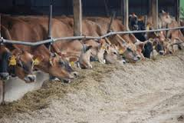
How is MPP IOFC Defined?
Income Over Feed Cost (IOFC) margin
  IOFC ($/cwt of milk) ≡
  U.S. Avg. All-Milk price − Feed cost
  Feed Cost ($/cwt of milk) ≡
  U.S. average corn price received ($/bu) x 1.0728 +
  U.S. average alfalfa price ($/Ton)
  x 0.0137 +
  Central IL soybean meal (SBM) price, barge rate ($/Ton) x 0.00725
Final revised prices received obtained from Agricultural Prices report
Corn: 60.1 lbs
Alf.: 20.7 lbs
SBM: 14.5 lbs
Total 95.3 lbs
Published by USDA Agricultural Marketing Service (AMS)

Slide 9
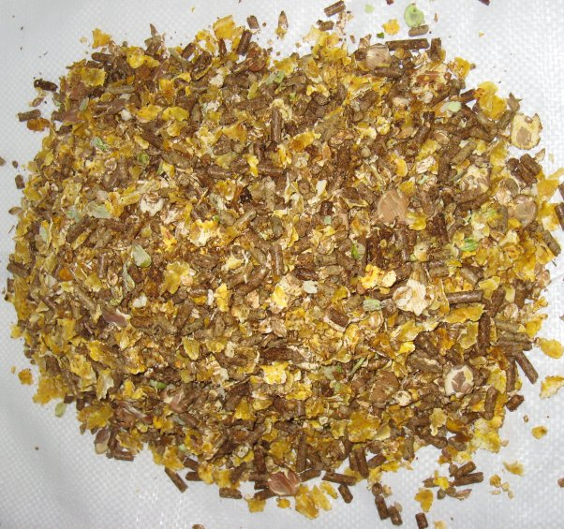
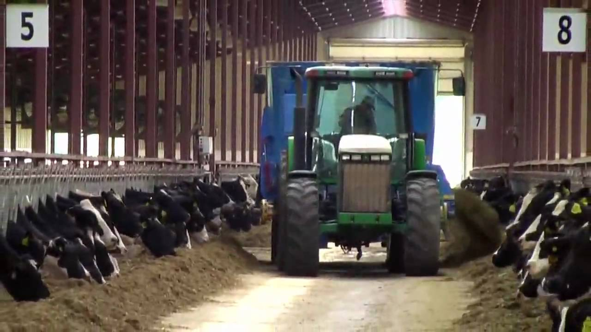
MPP Feed Cost Assumptions
Feed ration cost: Weighted average cost of feeding milk herd plus support animals
  Heifers, dry cows, hospital cows, bulls
    Same ration for entire contract
    Cost/cwt of milk change due to changing feed market
    conditions

Slide 10


When Can Producers Sign-up?
Sign-up can occur anytime over life of Farm Bill during designated sign-up periods
  For 2014/2015 coverage: Sept. 1st–Nov. 28th
  2016+: June 1st–Last business day of Sept.
  Only sign-up once
    Sign-up year can occur after 2014 until 2017
    After sign-up, enrolled until end of Farm Bill
  Annual program changes possible during regular sign-up period
    Percent of production insured
    Minimum IOFC target

Slide 11

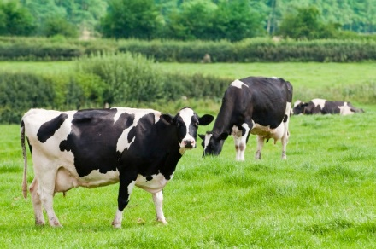

When Are Indemnities Determined?
Indemnity determination:
  Year divided into 6 two-month groupings:
    Jan/Feb, Mar/Apr, May/Jun, Jul/Aug, Sep/Oct, Nov/Dec
  Feed costs and milk revenue calculated monthly and averaged for each 2 month period

Slide 12

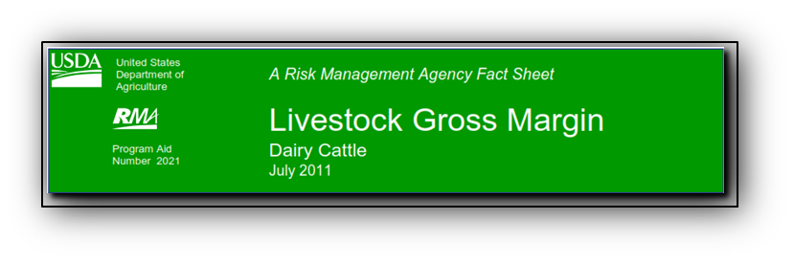
When Are Indemnities Determined?
Indemnity defined as difference between minimum insured IOFC and the 2-month average actual IOFC
  Actual IOFC using MPP
  6 indemnity evaluations each year
Contrasts with LGM-Dairy
  1 indemnity determination regardless of contract duration
  1 – 10 months of production can be insured

Slide 13

Are Farm-Level Prices Used in
MPP IOFC Calculations?
No farm-specific prices used
  Feed price
    Feed assumed purchased in national feed market
  Milk price
    U.S. national average value
    Milk assumed to be of average component composition
Need to determine basis between farm-specific vs. MPP IOFC’s
  Identify MPP level to achieve desired on-farm target

Slide 14
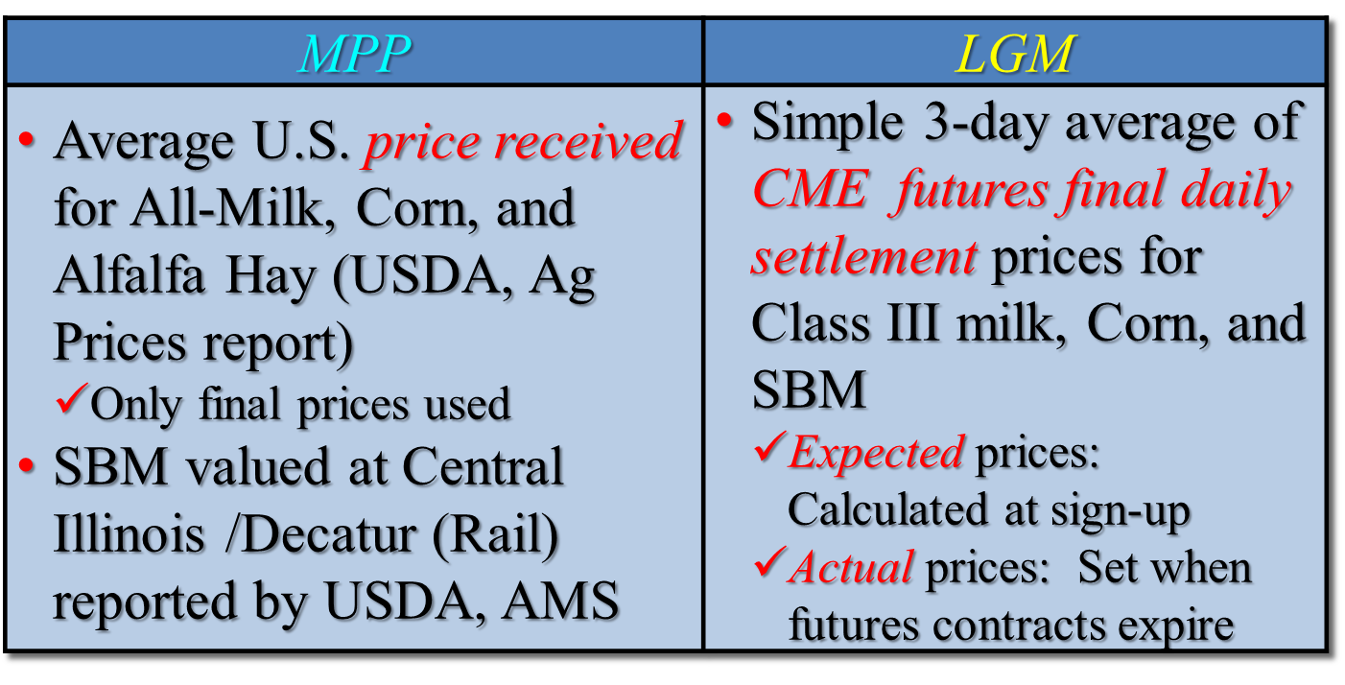
What Prices Are Used by the
MPP vs LGM-Dairy Programs?

Slide 15
What Prices Are Used by the
MPP vs LGM-Dairy Programs?
ρ_{All Milk, Class III} = 0.975 Avg. Basis = $1.45
Basis Std. Dev. = $0.839 Basis C.V. = 0.578

Slide 16
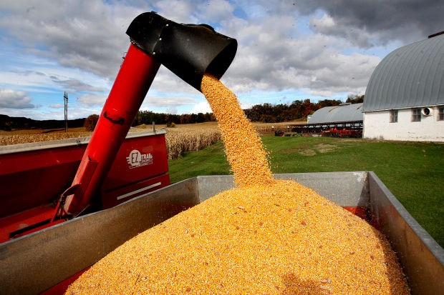
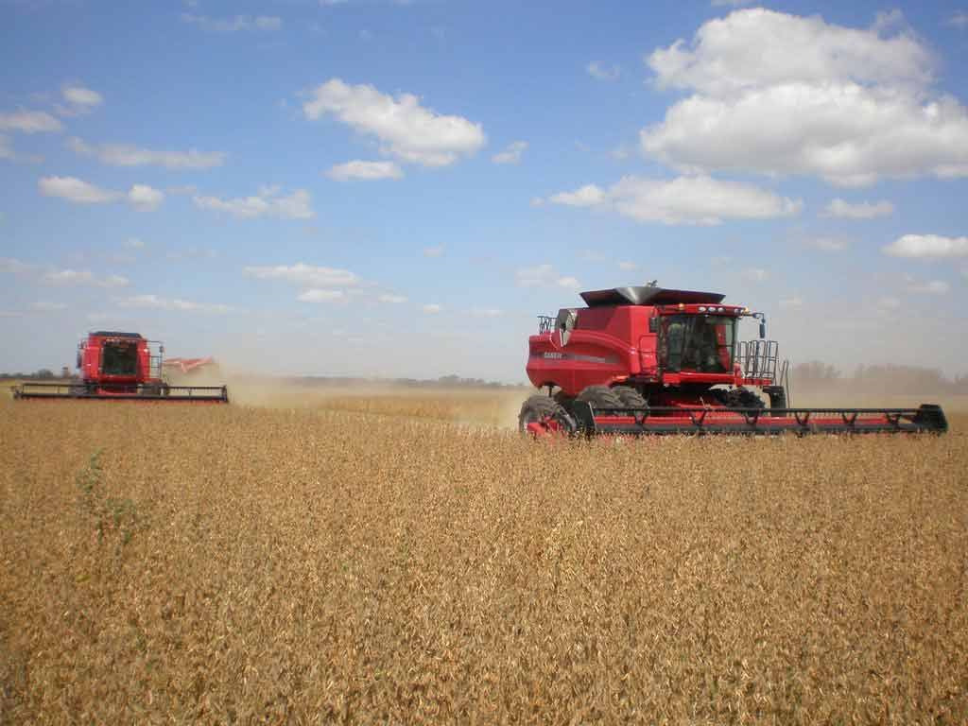
What Prices Are Used by the
MPP vs LGM-Dairy Programs?
ρ_{Cash, Futures} 0.986
Basis Characteristics
Mean −0.22
Std. Dev. 0.32
Coef. Var. 1.49
ρ_{Cash, Futures} 0.991
Basis Characteristics
Mean. 4.66
Std.Dev. 15.75
Coef. Var. 3.38

Slide 17
How Much Milk
Can Be Protected?
Determined by operation’s Actual Production History (APH)
  APH = Maximum annual production over 2011, 2012, and 2013
    Regardless of when operation enrolls in MPP
  APH can be revised annually
    APH increase: % total U.S. milk production ↑
      a.k.a. the production bump
    APH bump does not start until sign-up
    1st production bump in 2015: 087%

Slide 18
How Much Milk
Can Be Protected?
How much milk can be insured?
  Percent of APH insured is a producer decision variable
  25% to 90% of current APH in 5% increments
  Program assumption: % milk insured the same for all months during coverage year
    LGM-Dairy allows for variable percentage coverage across months within a single contract

Slide 19
What Range of Margins
Can Be Protected?
Minimum target IOFC is a producer decision variable
  $4.00 to $8.00/cwt IOFC in 50¢ increments
  Allowabel range does not change with changing milk and/or feed market conditions
    LGM-Dairy margin targets (and premiums) determined by sign-up futures market conditions

Slide 20
What Have Been Historical
MPP Margins
2014 IOFC Forecast Margin
Historical IOFC Margins
Margin Protection Available from $4.00 - $8.00/cwt

Slide 21
What Impacts Premium Rates?
Three main determinants
  IOFC insured
  Insuring more than 4 million lbs?
    Substantially higher rates for milk amounts insured greater than 4 million lbs
    Initial 4 million lbs always premiums based on lower cost schedule
  25% premium discount on 2014 and 2015 coverage for first 4 million lbs
    Except for $8.00 margin

Slide 22
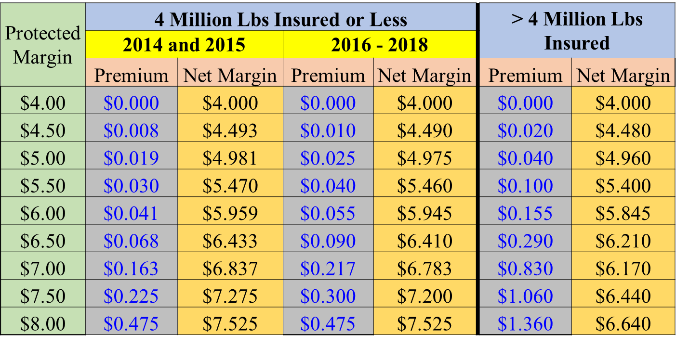
What Impacts Premium Rates?
Note: Net Margin = Margin Guarantee ─ Premium
For 2013, the annual average WI yield/cow was
21,353 lbs → 4 Mil. Lbs produced by 188 cow herd
54.0ȼ ↑ for 50.0ȼ
↑ in coverage

Slide 23
Are MPP Premiums Subsidized?
To what degree are MPP contracts subsidized?
  100% subsidy @ $4.00: $0 premium
  > $4.00: Implicit subsidy where value depends on milk and feed markets
  Program not self-financing
  Subsidy changes given
    Market conditions
    Margin target
    Whether amount of milk insured is in excess of 4 million lbs

Slide 24
When are Premiums Due?
There 2 alternatives:
  100% at sign-up; or
  25% min. by end of Feb., remainder by June 30th of insured year
This contrasts with LGM-Dairy
  LGM-Dairy premium not due until 11 months after contract purchase
Premiums subtracted from any indemnity payment forthcoming

Slide 25
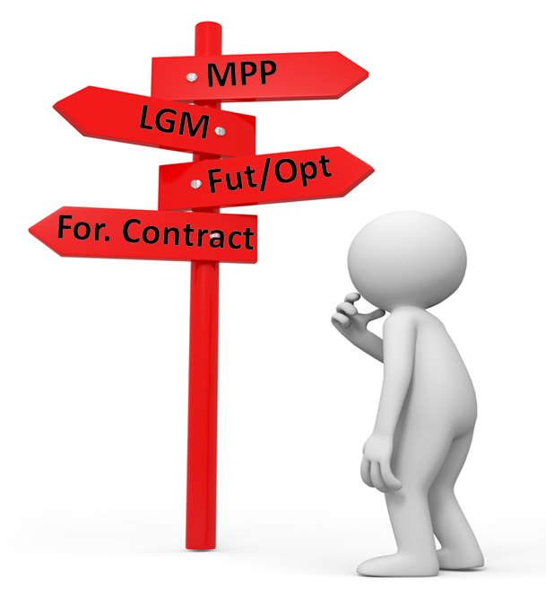
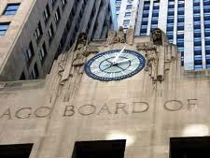
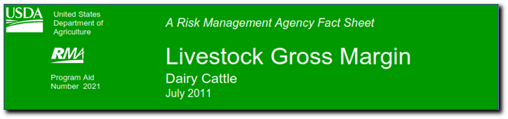
Use of MPP and Other Margin Risk Management Systems
MPP enrollment: No impact on ability to use other risk management systems except LGM-Dairy
  Cannot participate in both
  Use of LGM-Dairy impacts how to enroll in MPP if desired
  Use of MPP will impact the degree of use of other risk management systems

Slide 26
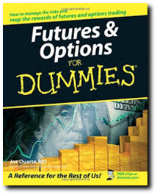

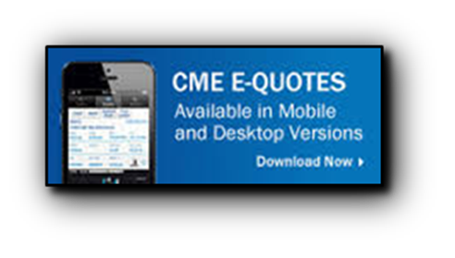
Use of MPP and Other Margin Risk Management Systems
If enrolled in MPP one can still
  Forward contract farm milk with processor and/or purchased feed from input supplier
  Continue to use futures and options if desired

Slide 27
Use of MPP and Other Margin Risk Management Systems
How can LGM-Dairy (MPP) user’s transition to use of MPP (LGM-Dairy)?
  Once purchased MPP contract holders cannot purchase LGM-Dairy
  LGM-Dairy contract holders have the ability to transition to MPP if desired
    Current LGM-Dairy contract holders can continue to use LGM-Dairy and just not sign up for MPP

Slide 28
Use of MPP and Other Margin Risk Management Systems
Alternative transition protocols if desired:
  2014/15: Contract holders can transition to MPP with coverage starting after fulfilling LGM contract
  After 2015: Cannot have active LGM contract for months covered by desired MPP contract
    i.e., No LGM-Dairy covered months after Dec. of prior year

Slide 29
MPP Issues?
Producer cannot set minimum IOFC above $8.00 even during good years
  Possible with LGM-Dairy as system based on CME futures and options
May not reflect a farm’s market risk due to use of national average prices
  How does an MPP-defined margin translate into a farm’s actual IOFC margin?
    Operation’s feed and milk price basis
    Use of home-grown feeds (i.e., not purchased in the marketplace)

Slide 30

MPP Issues?
Feed ration profile is fixed for all months
  Under LGM-Dairy farm-specific ration can vary across months
  Producer may want to only insure against purchased feed market risk
Amount of milk insured
  Slow APH growth regardless of on-farm expansion
  Milk in excess of 90% of APH uninsured

Slide 31
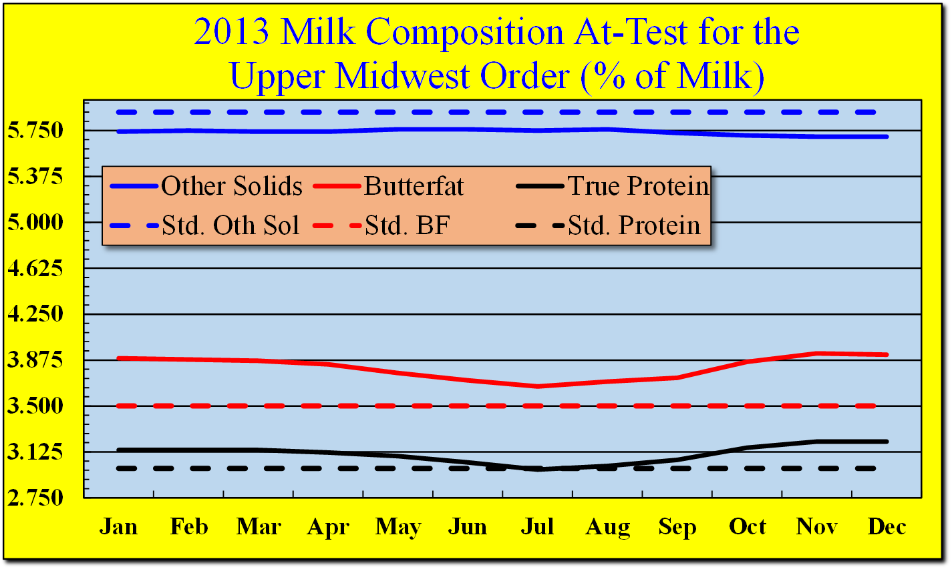
MPP Issues?
Milk components in excess of U.S. average uninsured
  Under MPP milk is assumed to have average quality and therefore price
May need to use other risk management systems to protect
  Extra value
  Uninsured cwt’s

Slide 32
Comparison of MPP vs. MILC
MILC program eliminated once MPP program in effect: i.e. Jan. 1, 2015

Slide 33
Comparison of MPP and LGM-Dairy Premiums
Original IOFC Target | 2014/15 Net Margin | MPP Premiums (< 4 mil lbs) |  | LGM Premiums by Deductible Level
 |  | 2014-15 | 2016-18 | $0 | $1 | $2
$4.50 | $4.493 | $0.008 | $0.010 | $0.18 | $0.06 | $0.02
$5.50 | $5.570 | $0.030 | $0.040 | $0.22 | $0.07 | $0.03
$6.50 | $6.433 | $0.068 | $0.090 | $0.26 | $0.08 | $0.03
$7.50 | $7.275 | $0.225 | $0.300 | $0.30 | $0.09 | $0.04
$8.00 | $7.525 | $0.475 | $0.475 | $0.31 | $0.10 | $0.04
For a $7.525 net return there is an average 6% indemnity prob. under MPP for the 5 bi-month evaluations
Under LGM @$1 deductible there is a 32% indemnity probability for the 10 month contract.
Note: LGM analysis undertaken on Sept. 24, 2014 for the Sept. contract. For LGM coverage we chose the least cost contract over the Nov, 2014 – Aug 2015 period that returns a net margin equal to the 2014/15 net margins shown in the 2nd column. The default feed ration is used. The unsubsidized LGM premiums can be obtained by dividing $0 deductible values by 0.82, $1 values by 0.48 and $2 values by 0.50 . The actual farm basis will differ across program.

Slide 34

MPP Decision-Making Resources
DMaP team: Dedicated MPP website:
  http://dairymarkets.org/MPP
Website contains links to software system designed to:
  Enable producers better understand MPP program
  Improve contract design
MPP Purchase Decision Tool
  http://dairymarkets.org/MPP/Tool

Slide 35

The MPP Participation Decision
Two types of farm operators:
  Those who have signed up going into a particular year
    Need to think about contract design
      % of APH insured
      Target IOFC
  Those who have yet to sign-up:
    Decide whether or not to sign-up
      One-time sign-up can happen anytime over Farm Bill life
    If decide to sign up, contract design needed

Slide 36
MPP Contract Decision:
Current Enrollees
Need to look forward for the 12 months encompassed by upcoming MPP contract
  3–15 months from end of MPP sign-up period
MPP decision tool used to forecast likely IOFC scenarios
  Expected IOFC’s
  Probability of IOFC levels
  Potential contract outcomes

Slide 37
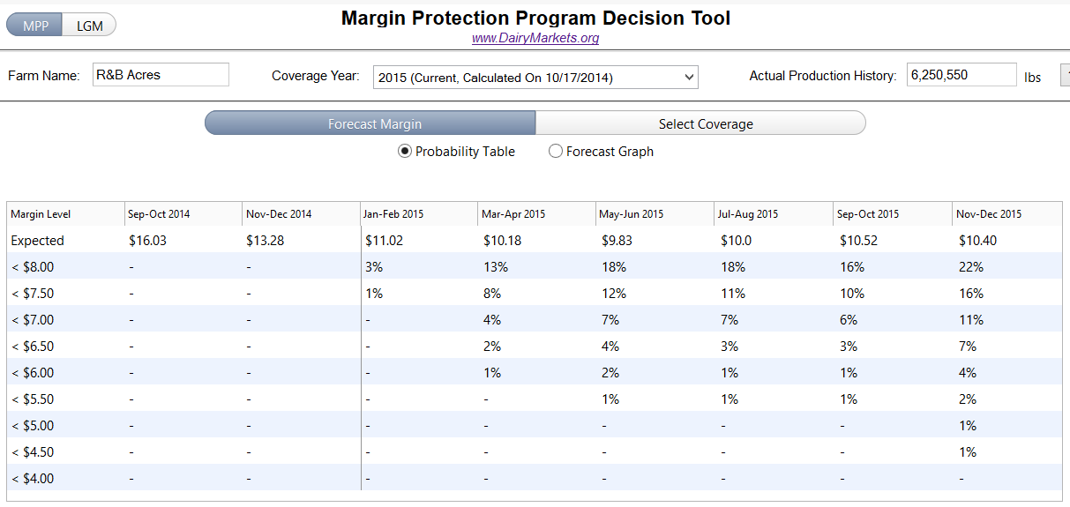
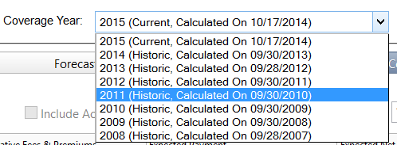
MPP Contract Decision:
Current Enrollees
Enter your APH (lbs)
Default Forecast Margin view of MPP Decision Tool
Do you want to analyze MPP
or LGM-Dairy program?
Coverage Year: Default is forward looking

Slide 38
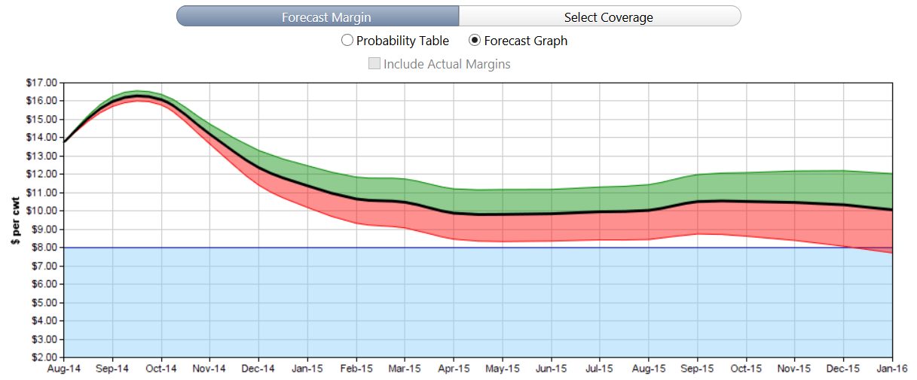
MPP Contract Decision:
Current Enrollees
Forecast Graph view of MPP Tool
Margin with a
25% prob. of
being above
forecast
Forecast
Margin Value
Expected
Margin
Dec ʹ15 Margin range with 50% probability of occurrence
Margin with a
25% prob. of
being below
forecast
Note: Based on futures and options data as of 10/17/2014

Slide 39
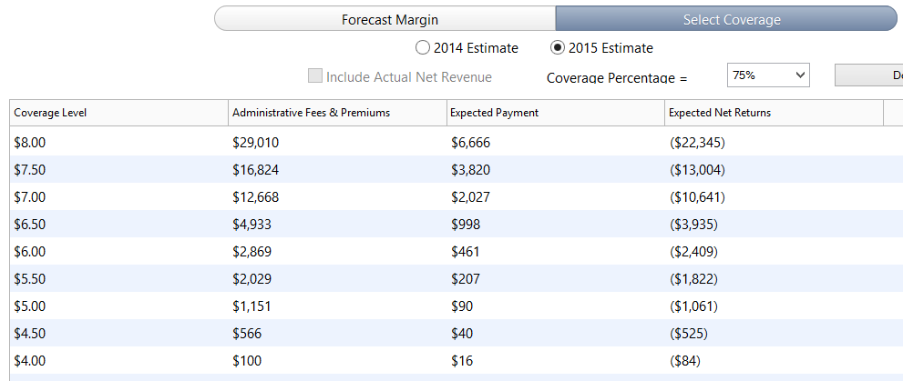

MPP Contract Decision:
Current Enrollees
Select Coverage view
Percent of Milk Insured
$100 + Premium
Expected Indemnity
Expected Indemnity − (Fee + Premium)

Slide 40


Contact Information
Professor Brian W. Gould
bwgould@wisc.edu
(608)263-3212
Understanding Dairy Markets website: future.aae.wisc.edu
Dairy Marketing and Policy (DMaP) group MPP-Dairy website:
www.dairymarkets.org/mpp

