Slide 1


Analysis of the MPP Program:
Available Software and Website Resources
Prof. Brian W. Gould
Department of Agricultural and Applied Economics
University of Wisconsin-Madison
University of Wisconsin Extension
August 27, 2014
Farm Services Agency
USDA
Rothschild, WI

Slide 2
Dairy Marketing and Policy
(DMaP) Group
Inter-university group of dairy economists
  University of Wisconsin: M. Stephenson & B. Gould
  Cornell University: A. Novakovic
  Michigan State University: C. Wolfe
  University of Minnesota: M. Bozic
  University of Illinois: J. Newton
  Ohio State University: C. Thraen
  Penn. State University: C. Nicholson
Recently awarded a multi-year Coop Agreement with FSA to provide MPP educational programming

Slide 3





Our MPP extension education efforts supported by the following:
The following USDA grant is acknowledged:
USDA-NIFA Award Number 2012-49200-20032

Slide 4
MPP Resources
The purpose of this presentation is to
  Familiarize you with resources developed by the DMaP group
  Alert you to resources available should questions concerning LGM-Dairy brought up by your clients
  Provide contact information
    To provide more detail
    To refer your clients should complicated questions be raised
This presentation can be obtained from the following URL within the DMaP website:

Slide 5
Agricultural Act of 2014
Besides creating the MPP program:
  Creates a dairy product donation program in effect when Income Over Feed Cost (IOFC) below $4/cwt
    Secretary has considerable latitude in determining purchased dairy product amounts
    Unlike support program purchases cannot enter commercial market but must be donated
  Repeals MILC program after MPP operational
  Repeals: Dairy product price support program

Slide 6
Agricultural Act of 2014
Besides creating the MPP program:
Repeals: Dairy export incentive program (i.e., the DEIP program)
Renews: Dairy forward pricing program for Class II – Class IV milk purchased by private dairy product manufacturers
  Cooperatives have always had this ability
Allows: Establishment of a Potential CA Federal Order
  Some language as to how to transition but little detail

Slide 7
MPP Resources
Anticipated alternative information and educational resources available from:
  FSA-based
  Farm organizations
  Cooperatives/private processors
  University faculty/extension staff
    DMaP dairy economists group:
    http://dairymarkets.org/MPP
  Farm credit system
  Management firms
If you become aware of websites/other resources send a note to DMaP team member

Slide 8
DMaP MPP Resources
We have a dedicated MPP website:
  http://www.dairymarkets.org/MPP
Available on that website are links to two software systems designed explicitly to help your clients better understand the MPP program
  MPP Dashboard
  MPP Purchase Decision Tool

Slide 9
The MPP Dashboard
Software system used to undertake what-if type of analysis
  What would have been the outcome if MPP had been available starting in 2000?
    We ignore the impact that MPP existence would have had on historical milk production amounts
Two identical versions available:
  Web-based:
  farmdocdaily.illinois.edu/tools/flash_dairy_dashboard_010514.html
  PDF based:

Slide 10
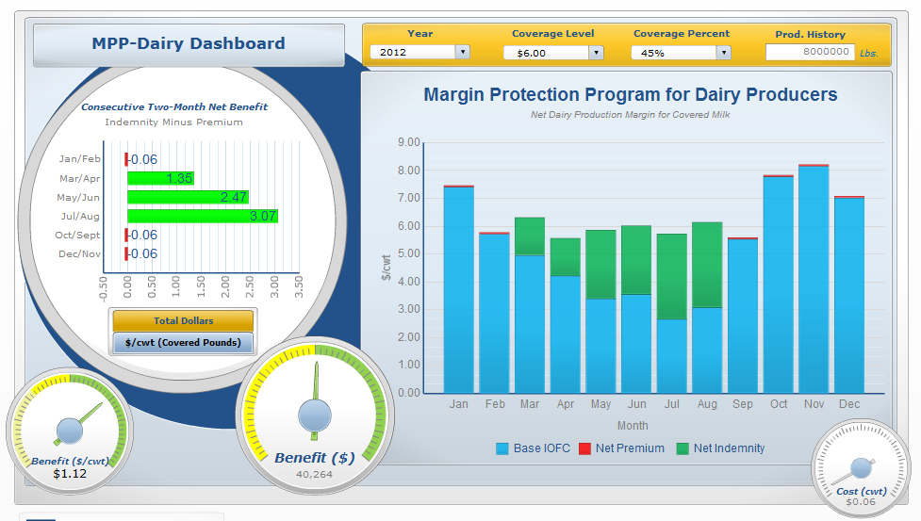
The MPP Dashboard
Year
(2000-2015)
Min. IOFC
($4.00-$8.00)
% of Prod. Insured
(25%-90%)
APH
(Max[2011-2013])

Slide 11
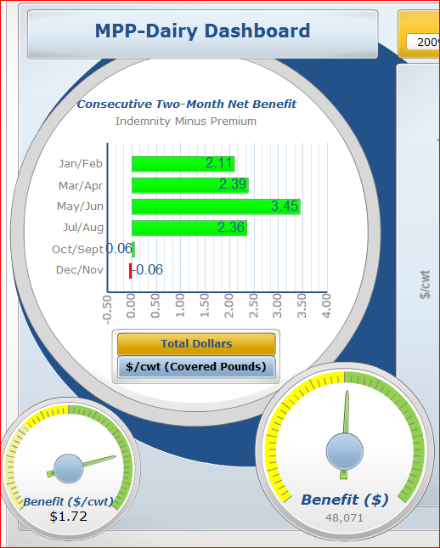

The MPP Dashboard
  www.farmdocdaily.illinois.edu/tools/flash_dairy_dashboard_010514.html

Slide 12
The MPP Dashboard
Lets go through a simple example
  3.5 million lbs APH
  80% coverage
  $4.00 - $8.00 coverage
  2008 & 2009

Slide 13
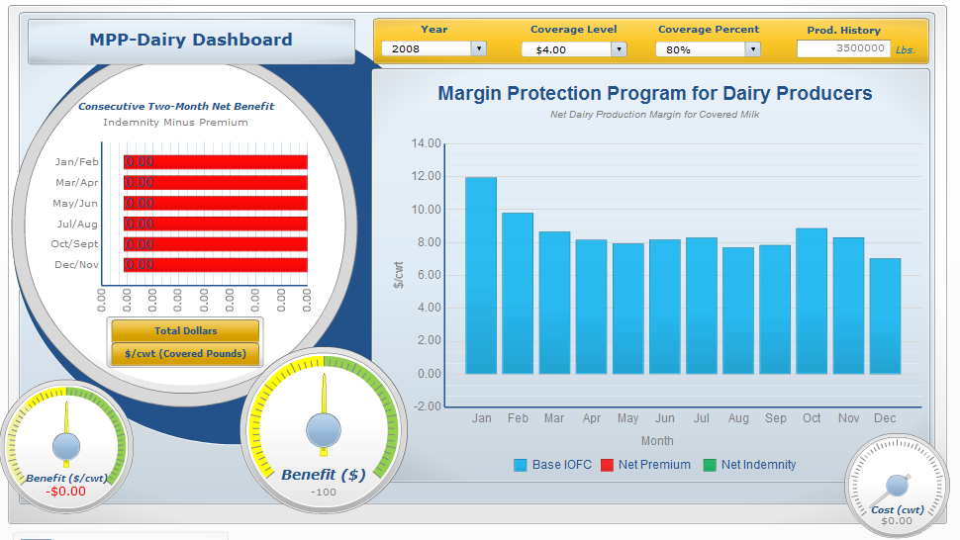
The MPP Dashboard
Avg. IOFC = $8.57
  www.farmdocdaily.illinois.edu/tools/flash_dairy_dashboard_010514.html

Slide 14
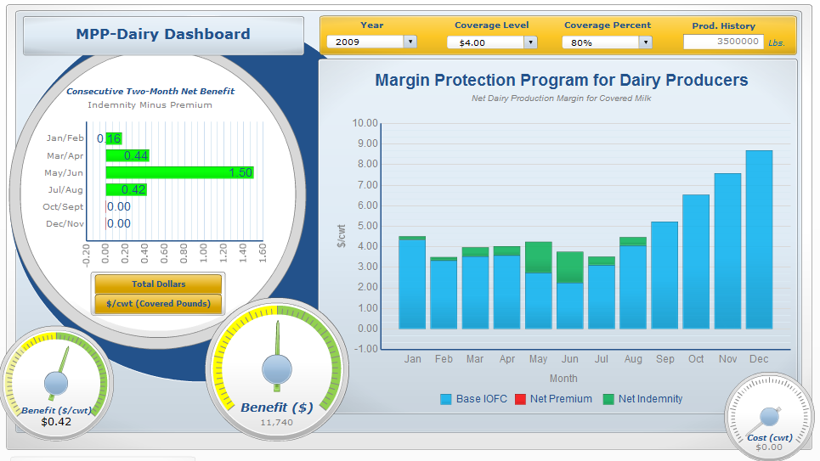
The MPP Dashboard
Avg. IOFC = $4.58
  www.farmdocdaily.illinois.edu/tools/flash_dairy_dashboard_010514.html

Slide 15
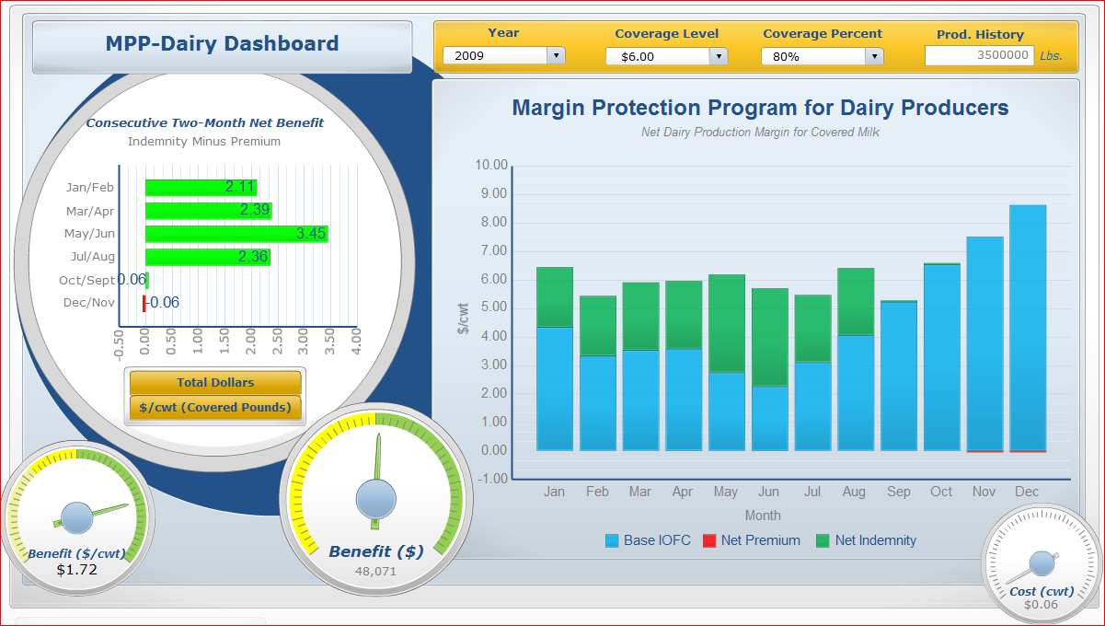
The MPP Dashboard
Avg. IOFC = $4.58
  www.farmdocdaily.illinois.edu/tools/flash_dairy_dashboard_010514.html

Slide 16
The MPP Participation Decision
Two types of individuals:
  Those who have signed up going into a particular year and need to think about contract design
  Those who have not signed up and have to
    Decide whether or not to sign-up
    If signing up, design the contract
Either type of individual needs an estimate of IOFC over the next year
Lets first talk about those who have already signed up

Slide 17
Contract Decision: Already Signed Up
For those currently enrolled there will be annual decisions as to:
  Minimum IOFC protected
  Percent of current APH that will be insured
Need to look forward for the 12 months encompassed by the next MPP contract
DMaP team has developed a tool to forecast likely IOFC scenarios
  Based on current (i.e., date of analysis) futures market conditions
  Dairy Margin Protection Decision Tool

Slide 18
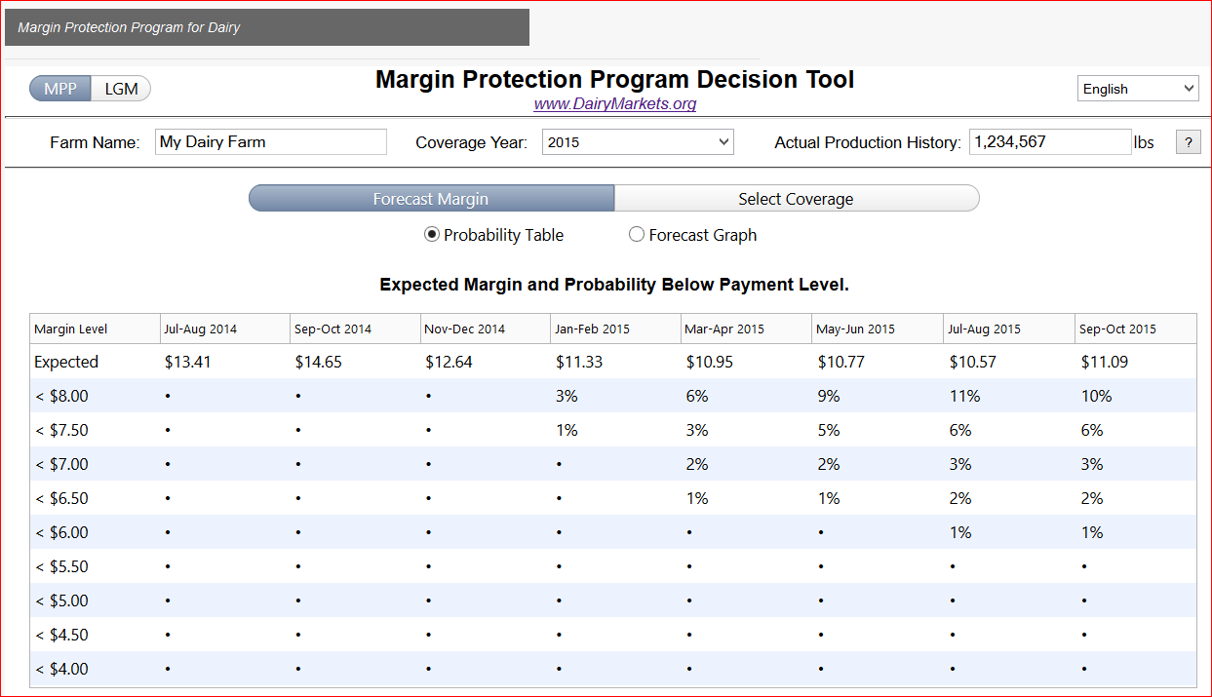
Contract Decision: Already Signed Up
Default view of MPP Decision Tool
Do you want to analyze MPP
or LGM-Dairy program?
English or Spanish?
Coverage Year: Default is forward looking
Enter your APH (lbs)

Slide 19
Contract Decision: Already Signed Up
Probability table view
Forecast coverage year bi-monthly IOFC’s
Do you want to display the forecast Probability Table or Forecast Graph?
Probability that Jul-Aug 2015 IOFC will be less than $7.00

Slide 20
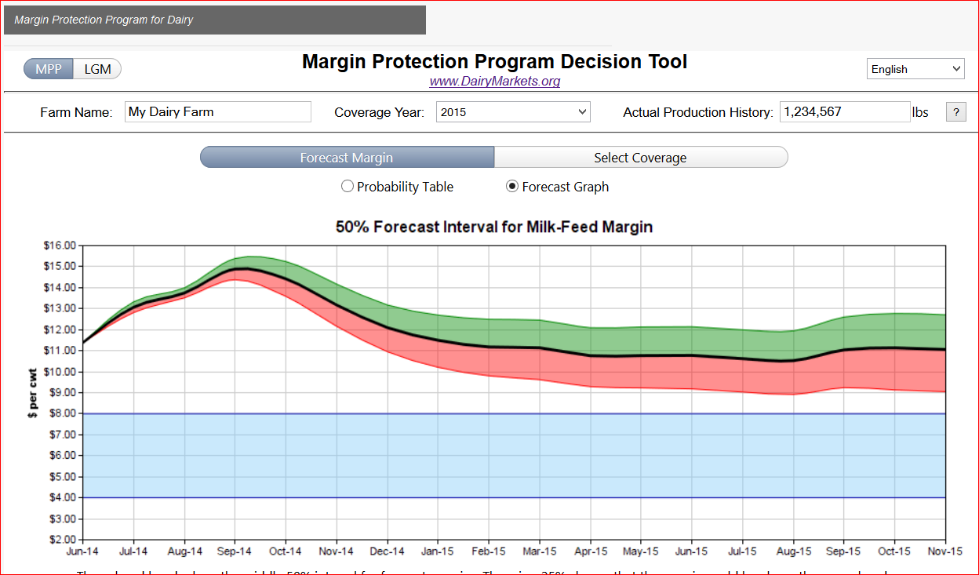
Contract Decision: Already Signed Up
Forecast graph view
IOFC’s with 25% probability of being above forecast IOFC
IOFC’s with 25% probability of being below forecast IOFC
Predicted/Forecast IOFC

Slide 21
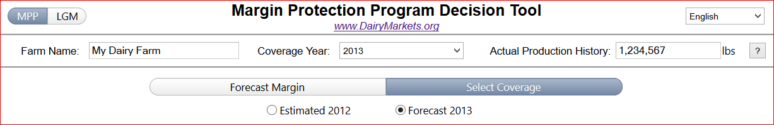
Contract Decision: Already Signed Up
Once you have looked at likely IOFC margins via the Forecast Margin part of the program, what are expected:
  Premium costs for a particular policy?
  Net returns for that policy (= Payments – Costs)
To answer the above, click on the Selected Coverage portion of the program

Slide 22
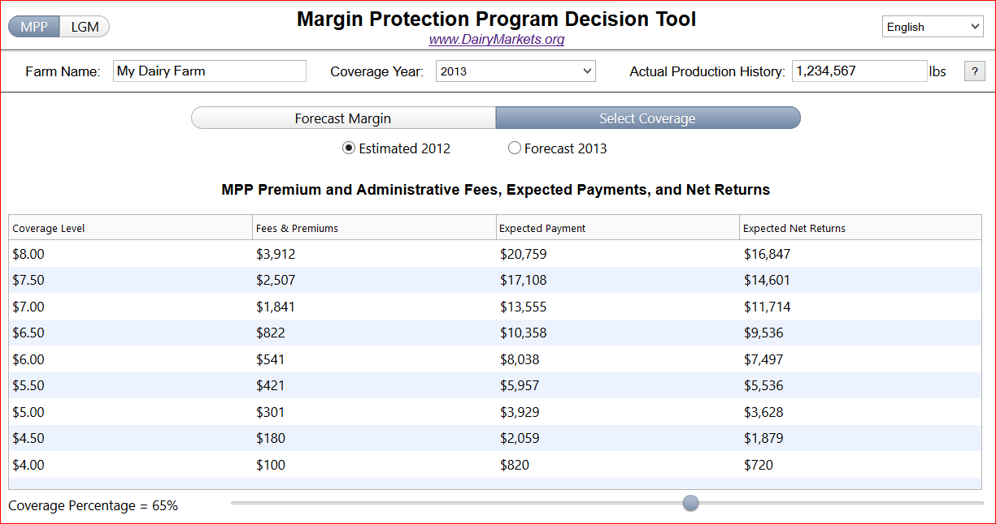
Contract Decision: Already Signed Up
For 2013 design decision the 2012 data is history
IOFC Target
Contract Costs = Premium + $100
Estimated Payments
Estimated Payments – Contract Costs
Move this icon to set Coverage %

Slide 23
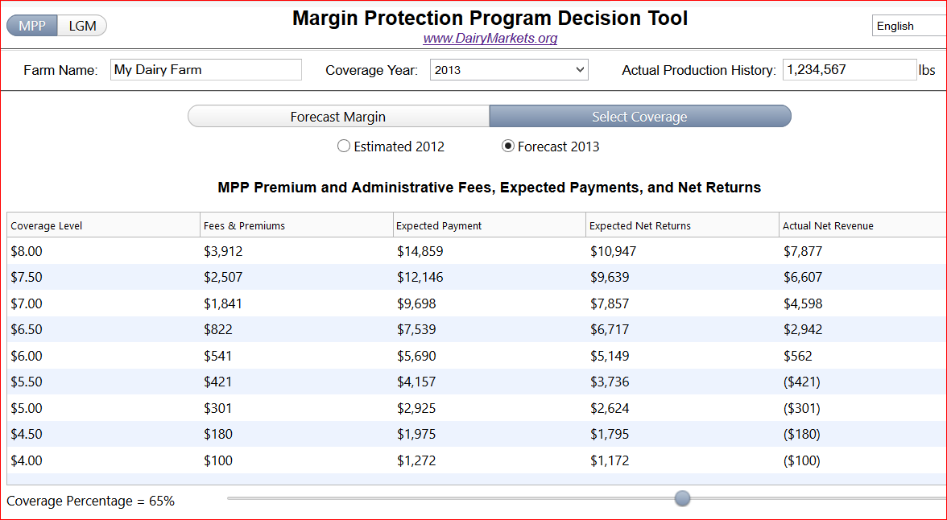
Contract Decision: Already Signed Up
2013 design parameters: % Coverage/IOFC Target
IOFC Target
Actual Payments – Contract Costs
Contract Costs = Premium + $100
Forecast Payments
Forecast Payments – Contract Costs
Move this icon to set Coverage %

Slide 24
Contract Decision: Considering Sign-Up
If a producer is not a currently enrolled in MPP:
  May want to compare LGM-Dairy with MPP given restriction of not being able to enroll in both
  One can enroll for any year up to and including 2018
    Once enrolled, operation is enrolled until end of 2018

Slide 25
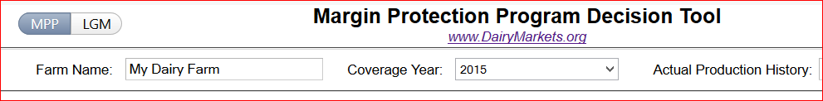
Contract Decision: Considering Sign-Up
The MPP decision tool allows immediate access to LGM-Dairy Analyzer software program:
When you click on the above you are directed to the following web page:

Slide 26
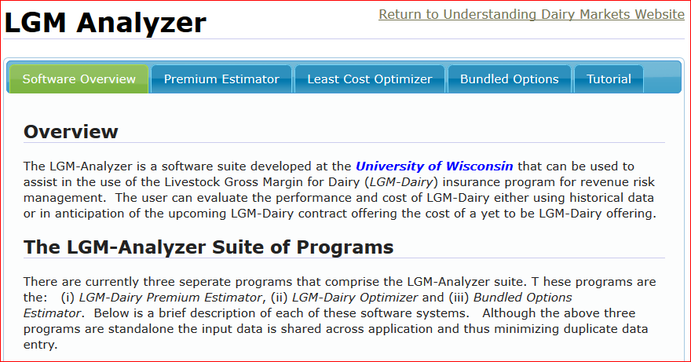
Contract Decision: Considering Sign-Up
Software for comparing LGM-Dairy and MPP

Slide 27
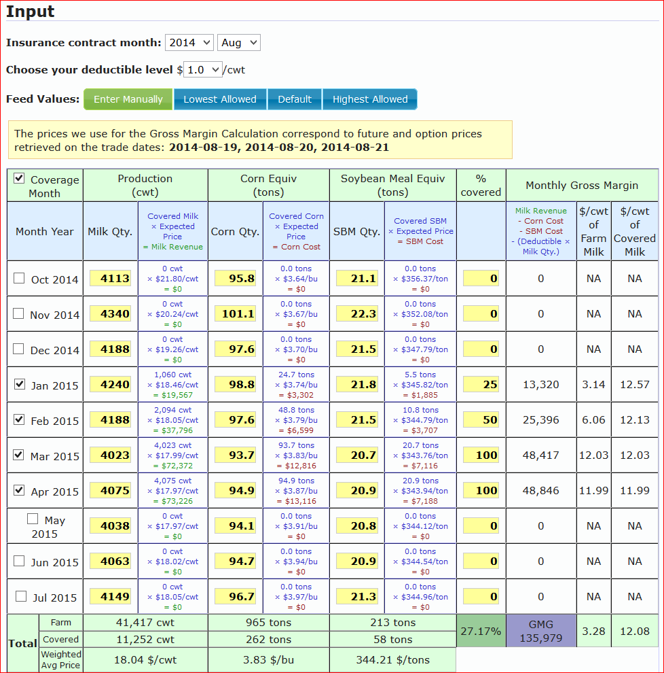
For more assistance with LGM-Dairy you may want to have your clients
  Access the full LGM-Dairy website: http://future.aae.wisc.edu/lgm_dairy.html
  Contact Prof. Gould using information to follow

Slide 28


Contact Information
Professor Brian W. Gould
bwgould@wisc.edu
(608)263-3212
MPP Information: Dairy Marketing and Policy (DMaP) dairy economist group website:
www.dairymarkets.org/mpp
www.farmdocdaily.llinois.edu

